Slide 1

PHP
Hypertext Pre Processor

Slide 2
Agenda
What is PHP
History of PHP
Why PHP
Usage of PHP
Prerequisites
Sample php Page
Dynamic content in PHP
Fundamentals of PHP
PHP & MySQL
OOPS in PHP
Web services
Ajax & Jquery
Advancements
Publishing PHP Projects

Slide 3
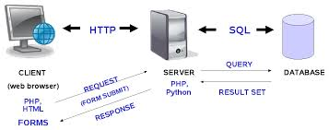
PHP – 3 tier Architecture

Slide 4
What is PHP
Server side Scripting Language
Embedded in HTML
Open source, Simple Syntax like C, C++
Ease of Learning
Used to manage Dynamic Content, most popular Databases (MySQL, PostgreSql, Oracle, Sybase, Informix, Microsoft SQL Server)
Supports major Protocols – IMAP, LDAP, etc.

Slide 5
History of PHP
Created in 1994 by Rasmus Lerdorf
simple set of Common Gateway Interface (CGI) binaries written in the C programming language
Personal Home Page – PHP –Static content display
Introduced - Forms Interpreter – Basic Form Submission – PHP/FI
PHP 3 – recursive acronym – Hypertext pre processor
Andi Gutmans and Zeev Suraski - they needed to power an eCommerce application they were developing for a university project – ZEND Engine.
Current version of PHP 7
Supports Cross Platform – can run in Windows / Linux

Slide 6
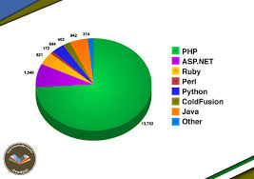
Why PHP

Slide 7
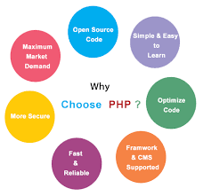

Slide 8
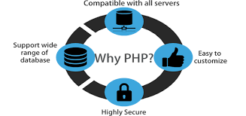

Slide 9
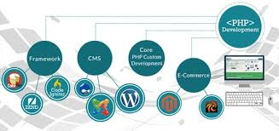

Slide 10
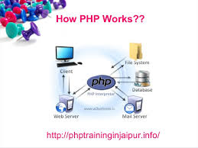

Slide 11
Uses of PHP
Outputs HTML Content to the Browser
Parses XML files
With extra libraries, it is used to convert the html content as a PDF, E-mail, Images, zip files etc..
Off-line scripting language – without browser – as Command line Interface

Slide 12
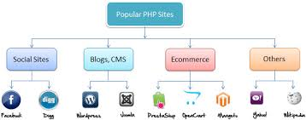
Who uses PHP

Slide 13
Prerequisites
HTML
CSS
XAMPP – (Windows / Linux) – Apache server, MySql Database, PHP, PERL
Jquery
C++
Editors –Notepad++, Sublime text, PHP Storm…

Slide 14
Sample PHP
<!DOCTYPE html>
<html>
<head>
<title>PHP Test</title>
</head>
<body>
<?php echo “<p>Hello World</p>”; ?>
</body>
</html>

Slide 15
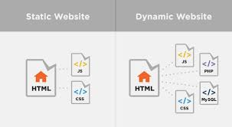
Dynamic PHP

Slide 16
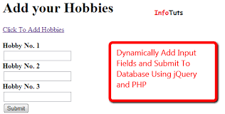

Slide 17
Fundamentals of PHP
Variables & Constants
<?php $var = 'Bob'; $Var = 'Joe'; echo "$var, $Var"; // outputs "Bob, Joe" ?>
String Functions
strtolower, strtoupper, strlen..
Array Functions
<?php
$array = [ “name" => “JPA Solutions", “branch" => “velachery",
“location" => “chennai" ]; ?>

Slide 18
Loop Control Structures
For Loop
While Loop
Do-while Loop
Foreach Loop
Usage of Break and Continue
Decision Making
Using if...else statement
Using else if statement
Using switch statement

Slide 19
Operators
Arithmetic Operators
Comparison Operators
Logical (or Relational) Operators
Assignment Operators
Conditional (or ternary) Operators
Form Handling
GET Method
POST Method
Single Page Form Processing
Multiple Page Form Processing
Page Redirection

Slide 20
Functions
Built-in Functions
User - Defined Functions
Returning Values
Default Values to parameters
Scope of the variables in PHP
Pass by Value vs Reference
Dynamic Function Calls
Conditional functions

Slide 21
Cookies & Sessions
Setting Cookies with PHP
Accessing Cookies with PHP
Deleting Cookie with PHP
Create a cookie which expires in 10 seconds
Language Preference - Storing user selected language preference in cookie
To Implement Remember Password
Server Session Storage
Setting and Reading Session Data
Shopping Cart - Storing an array of product ids in cart
Authenticate pages with login using session

Slide 22
More on PHP
Working with files
Creating Files, Directories
File Modes
Reading, Writing to Files
Closing, Deleting Files
Checking if File Exists
E-mail Handling
Send email using mail () function
Send email using SMTP
Collecting form data and send in email
Sending file Attachments

Slide 23
Learning MySQL
MYSQL Introduction
Basic Queries like Insert / Update / Delete / Drop / Truncate
Join Queries
Math operational Queries
Getting started with PHPMyAdmin Panel

Slide 24
Database Connectivity
Database Connection
Inserting, Updating, Deleting a record
SQL Injection
Escaping strings for MySQL

Slide 25
Oops in php
Understanding Objects and Classes
Defining Class Properties
Defining Class Methods
Using Constructors and Destructors
Using Class Inheritance
Visibility of Properties and Methods (Public, Private Protected, Static)
Exception Handling with Try Catch and Finally
Interfaces and Abstract Class

Slide 26
AJAX & JQuery
Introduction to JavaScript
Introduction to jQuery (JavaScript library)
Basic DOM handling with jQuery
AJAX concept
Implementing AJAX with jQuery
JSON handling with jQuery
Form Validation
Using third party library
Jquery is a Fast, Simplest and feature – rich JavaScript library
Makes HTML document traversal and manipulation, event handling, animation and ease to use API that works across multiple browsers.

Slide 27
CMS
Content Management System
Used to manage the Content of a website
Used to give various level of access to the Users to manage the content
Users can modify the web content and the DB content on their own without any software knowledge and can publish their site with little effort of work

Slide 28
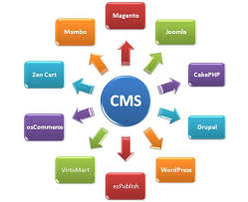
PHP - CMS
osCommerce
Wordpress
Joomla
Zen Cart
Drupal
Magento

Slide 29
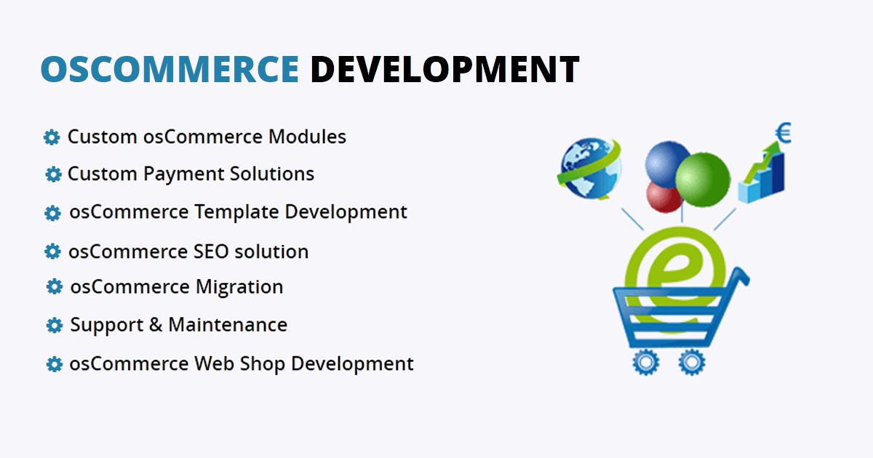

Slide 30
Frameworks
Reusable, maintainable code facilitates the speed of web development
Scalability, High level of Security
MVC – Model View Controller pattern
Makes the Code Cleaner and Extensible
API Services

Slide 31
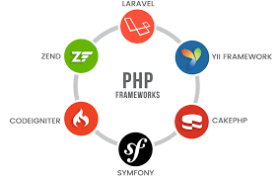

Slide 32
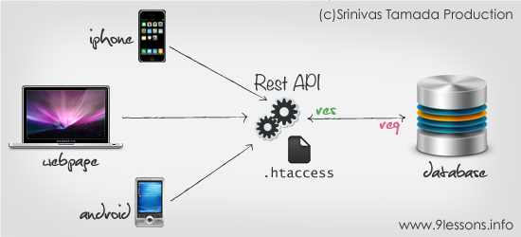
API Services

Slide 33
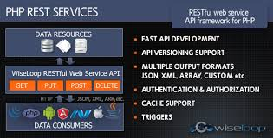
Uses of API Services

Slide 34
More on PHP
PDF generation using Library
Image Processing using Library
Image GD / Imagick Extensions
Upload image and resize / thumbnail
Adding Text on Images
Applying Watermark to Images

Slide 35
More on PHP
PayPal Payment Gateway Integration
Facebook API Integration
Work on Live Project
Publishing the project
Uploading local application to live server
Handling Cpanel
Handling FileZilla

Slide 36
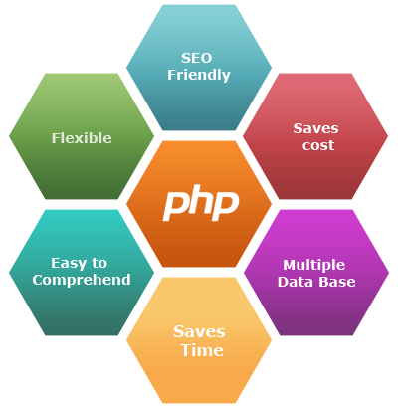

Slide 37
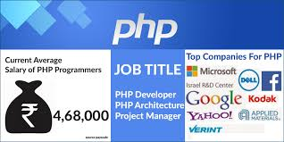
Let’s begin a life as a PHP Developer..

Slide 38
Thank you
Maduravalli

